Slide 1
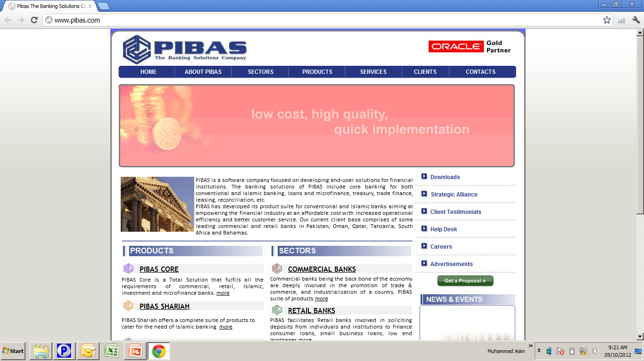
Business Relationship Management BR
Business Relationship Management (BR)

Slide 2
Contents
Business Relationship Management BR
BR Management
BR Supervision
BR Inquiry
BR Parameters
Br Reports

Slide 3
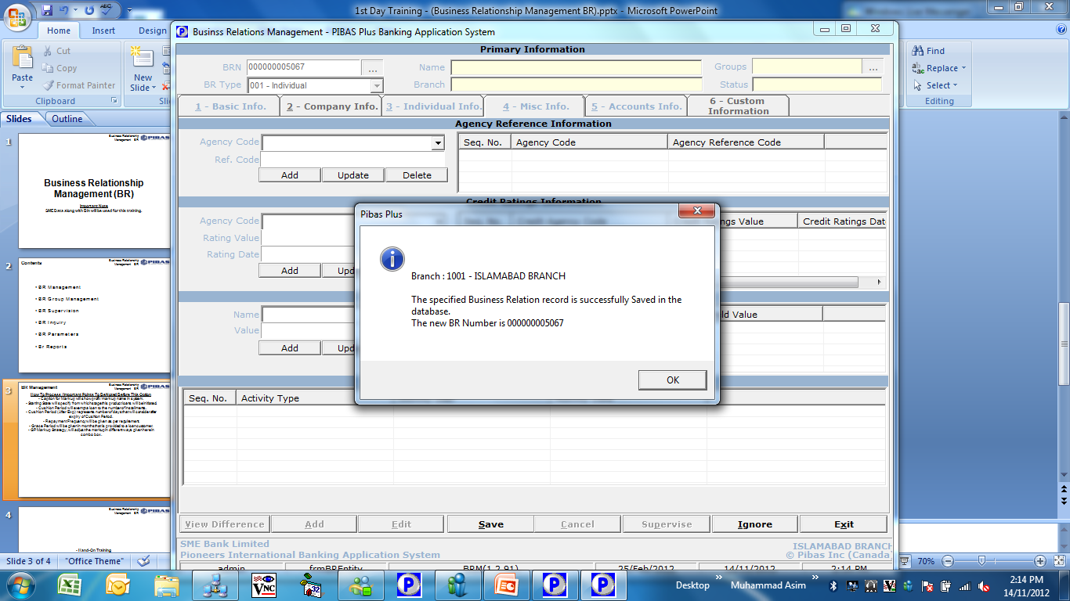
Business Relationship Management BR
BR Management
How To Process / Important Points To Be Noted Before This Option
This option will be used before opening of an account
This option can be considered first information recorder of new customer / new relationship.
Under one BR, many different accounts with different account types and with different branches can be opened. So BR is resides in system on Bank Level not Branch / Unit Level.
The same screen is used to change / delete any existing BR record.
BR is actually SBP’s requirement with respect to KYC Know Your Customer
BR can be created not only for customer but lawyers, suppliers, vendors and other service providers as well.

Slide 4
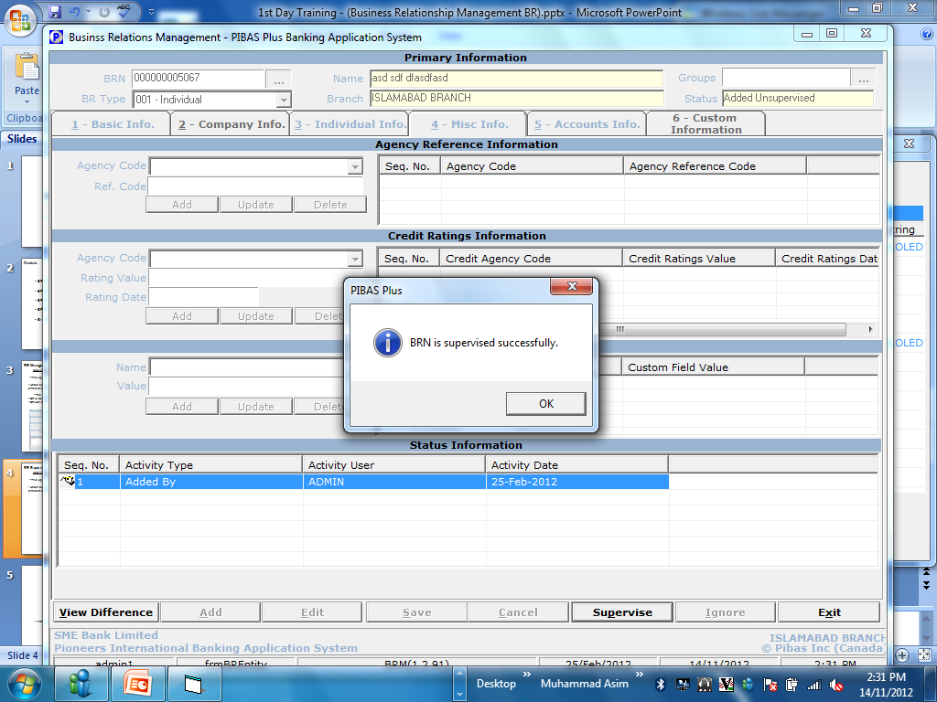
Business Relationship Management BR
BR Supervision
How To Process / Important Points To Be Noted Before This Option
This option is used for supervisor who can supervise any BR Record
Same use cannot supervise any record whether it is new or amended
This option is also used for view differences and cancellation of any change / addition.

Slide 5
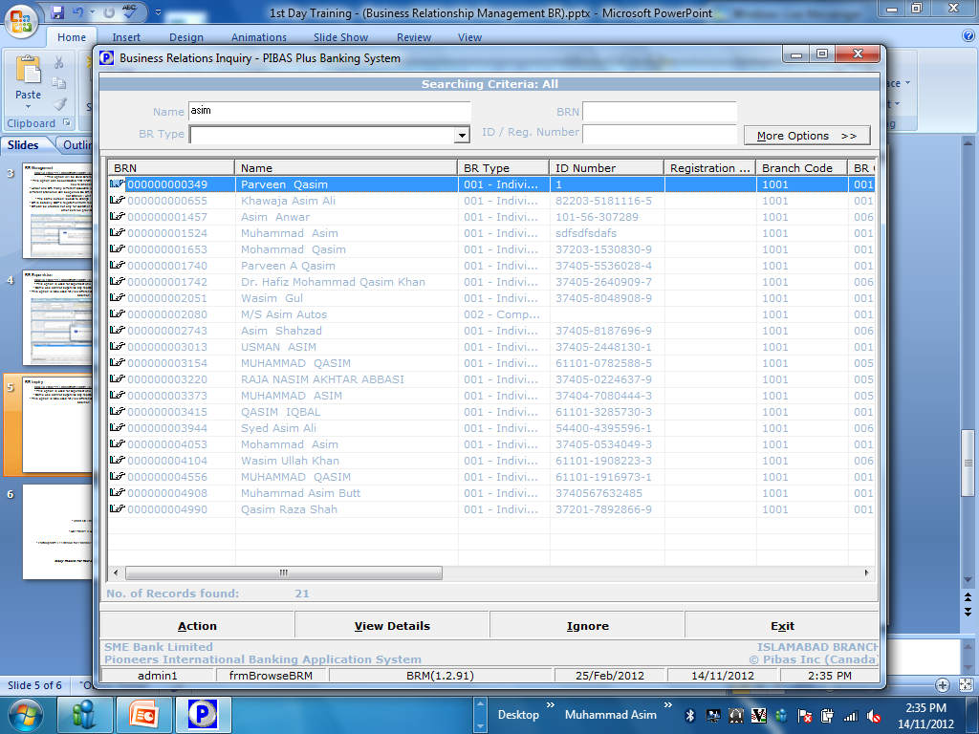
Business Relationship Management BR
BR Inquiry
How To Process / Important Points To Be Noted Before This Option
This option is used to locate / inquiry any BR Record in system.
Any required BR could be inquired in more detail just double clicking.
In addition to the following search condition, some more options are also available that can be viewed by clicking button “More Options >>”

Slide 6
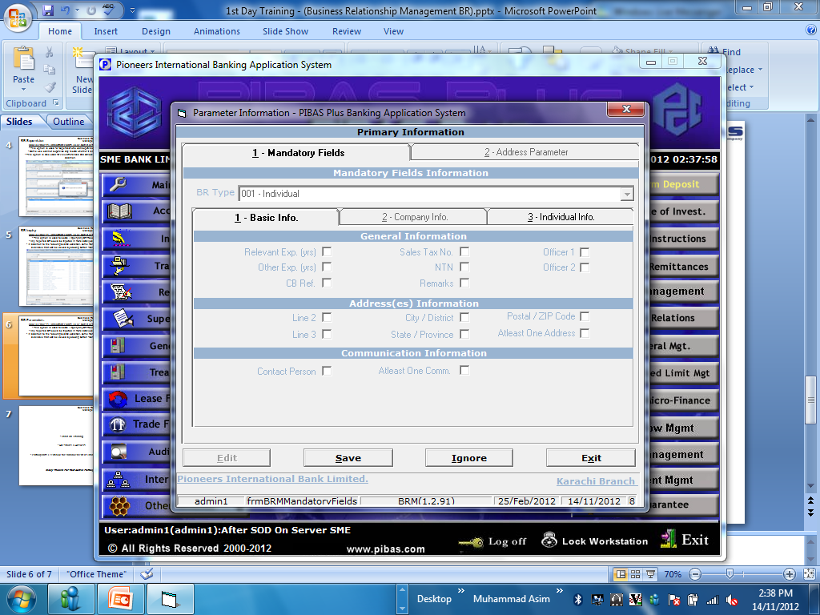
Business Relationship Management BR
BR Parameters
How To Process / Important Points To Be Noted Before This Option
Here, different parameters of different BR Categories could be defined / amended / added.

Slide 7
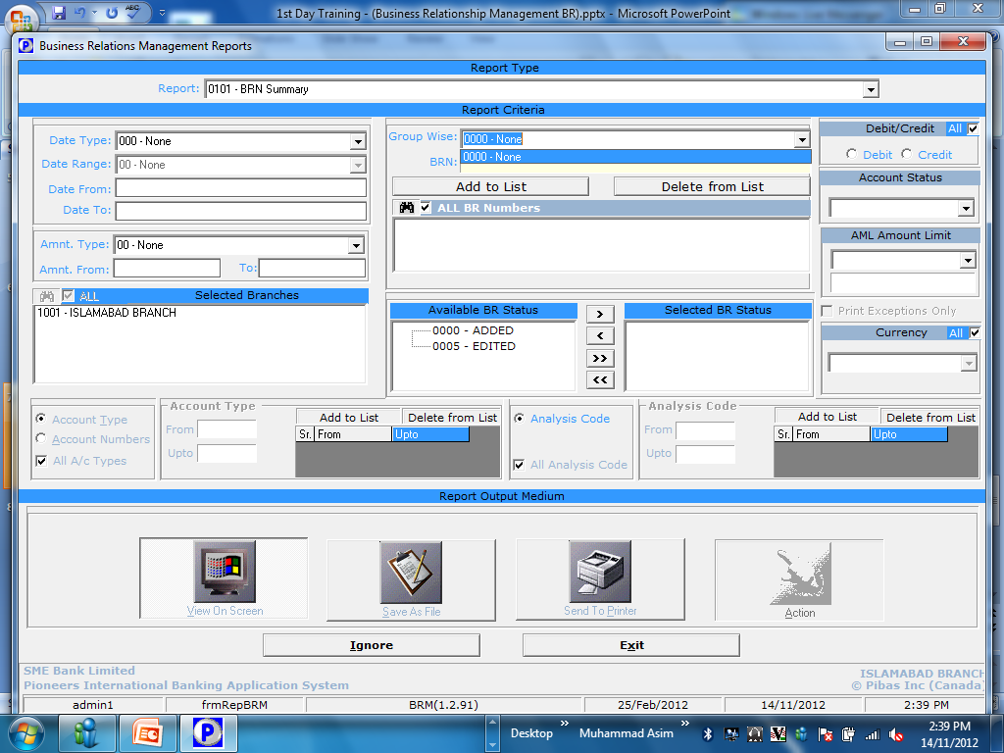
Br Reports
Business Relationship Management BR
How To Process / Important Points To Be Noted Before This Option
Provides a comprehensive information regarding Br

